Slide 1
Productivity
Ratio of the amount of goods and services produced (output) per unit of productive resources used (input).
As a ratio, productivity can be increased by:
producing more goods and services with the same amount of resources
or
by producing the same amount of goods and services with fewer resources.

Slide 2
Productivity
Personal and national standards of living are directly related to labor productivity.
The greater an individual’s labor productivity, the higher wage that individual can command.
People must produce more per person if they are to receive more per person.
Individual workers can increase productivity by investing in education and training (human capital).

Slide 3
Participate in a simulation that will demonstrate:
How productivity is calculated
The factors that can increase productivity
Work in teams of four to produce pizzas (made of paper).

Slide 4
How to make a pizza:
Trace the template (a small paper plate) on a piece of 8.5″ x 11″ paper.
Cut out the circle.
Draw 10 pepperoni pieces, about 1″ in diameter, on the pizza, using the red marker.
Draw 15 black olive slices, ½″ to ¾″ in diameter, on the pizza, using the black marker.

Slide 5
Each round will be three minutes long.
At the end of each round, quality control experts will determine if pizzas meet standards.
Complete the data chart (Activity 8.1).
Round 1:
Each employee will work alone.
Employees must complete one pizza before moving on to the next.

Slide 6
Thoughts on how to improve productivity?
Round 2:
Assign each employee a different task.
You may work on more than one pizza at a time.
You are limited to the same resources as in Round 1.

Slide 7
Thoughts on how to improve productivity?
Round 3:
Each team may acquire a capital good: a machine that pre-cuts pizza dough (paper plates).
Machine rental is $2.50 per round.
Reorganize the factory.

Slide 8
How was productivity calculated?
Labor productivity = output per worker over a set time
What happened to productivity between Round 1 and Round 2, and between Round 2 and Round 3? Why did this occur?
What happened to quality between Round 2 and Round 3?
What effect did investing in capital goods (the pizza-cutting machine) have on productivity?
What effect did increased productivity have on average costs (row 10, Activity 8.1)? Why is this important?

Slide 9
What effect will increased productivity in the pizza factory have on wages?
What happens if labor productivity increases in the overall economy?
What costs were incurred by attempts to increase productivity?
What are the advantages and disadvantages of specialization and division of labor?
What else could the pizza factory do to increase productivity?
What should a company consider before investing in capital, such as the pizza-cutting machine?

Slide 10
Factors That Increased Productivity
Specialization/division of labor
Assigning small, repeatable tasks at which workers gain expertise, as in Round 2
Results in more output per unit of labor
Increase in human capital
Acquired through education/training, displayed in all three rounds
Investment in capital goods
Tools/machines/factories as in Round 3
Technology

Slide 11
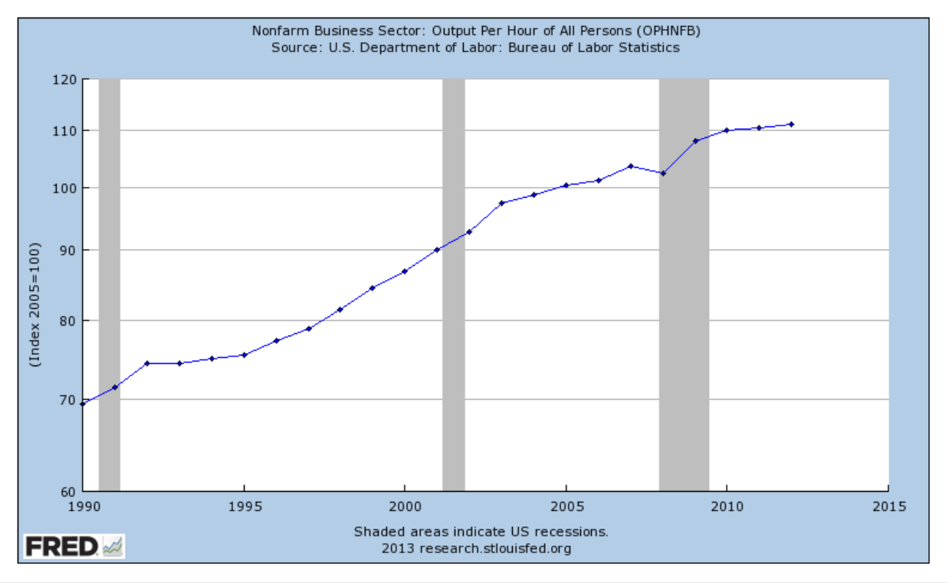
U.S. Labor Productivity
http://research.stlouisfed.org/fred2/series/OPHNFB

